Slide 1
Are Quantitative Research Indicators Good or Bad?
Special Workshop on Industrial and Applied Mathematics
Fundan University, Shanghai, P.R.China, February 11-13, 2011

Slide 2
Quantitative Assessment
Is there a need for ranking of
individuals, mathematics departments,
universities, countries,…?
Who needs or wants to do a ranking: Search committees,
department heads, university boards, funding agencies,
parliaments, ….
Notes:
- Aim: Ranking thinngs: We do it al the time
- Needed (we do it all the time! When buying things, bananas, …, sports (olympics, Tennis)
investment in AAA, AAA-,…
only in paradis Eva had no choice of men!
What ? In academics: a student shops for the best education
a department wants to hire the best people, wants to give salary according to ‘quality’
a political body wants to support institutions according to their ranking
Ranking across fields (compare mathematics with sociology) [Compare 100 meters running
with latin dancing]
How? Simple, quick, objective, unerring, with numbers, gut feeling,

Slide 3
Quantitative Assessment
Is there a need for ranking of
individuals, mathematics departments,
universities, countries,…?
Who needs or wants to do a ranking: Search committees,
department heads, university boards, funding agencies,
parliaments, ….
journalists, public, …
Notes:
- Aim: Ranking thinngs: We do it al the time
- Needed (we do it all the time! When buying things, bananas, …, sports (olympics, Tennis)
investment in AAA, AAA-,…
only in paradis Eva had no choice of men!
What ? In academics: a student shops for the best education
a department wants to hire the best people, wants to give salary according to ‘quality’
a political body wants to support institutions according to their ranking
Ranking across fields (compare mathematics with sociology) [Compare 100 meters running
with latin dancing]
How? Simple, quick, objective, unerring, with numbers, gut feeling,

Slide 4
Many Questions
What is a quantitative research indicator?
What are these used for?
Why?
Who uses them?
Can the indicators be manipulated?
Can the indicators be misused?
Are these good or bad?

Slide 5
What is a quantitative research indicator?
Ranking an individual
# of articles cut in smaller portions, repeat variations => rate journals
# of citations create community which cites itself => prevent manipulation
# of invited lectures contributed paper becomes invited => rate conferences
h-index, m-index,… create a scheme to be cited D.N. Arnold, K.Fowler 2010
# of Ph.D. students => rate students

Slide 6
What is a quantitative research indicator?
For an individual
3rd party money => rate organization which gives funds
# of pages written Smirnov solved exercises in his books

Slide 7
What is a quantitative research indicator?
Ranking a journal
Impact factor
Ranking by peer review
Evaluate journal by accreditation process

Slide 8
Societies Contribute
IMU, ICIAM, The IMS: joint committee on Quantitative
Assessment of Research: members
John Ewing (Providence, USA)
Robert Adler (Haifa, Israel)
Peter Taylor (Melbourne, Australia
Title of report: Citation statistics Release: 11 June 2008

Slide 9
Societies Contribute
IMU, ICIAM, The IMS: joint committee on Quantitative
Assessment of Research: members
John Ewing (Providence, USA)
Robert Adler (Haifa, Israel)
Peter Taylor (Melbourne, Australia)
Title of report: Citation statistics Release: 11 June 2008
IMU, ICIAM: New working group on
Journal Ranking and Pricing 19. 10. 2010

Slide 10
Impact Factor: What is it?
Impact factor for Journal X in year 2008:
Impact Factor = A / B
A = # of citations in all ISI articles during 2008 to
papers published in X during 2006-2007
B = # of articles published in X during 2006-07
# citations in year N in ISI
impact factor, year N = -----------------------------------------------
# articles in X during years N-1,N-2

Slide 11
Quality of Citation Databases
Thompson Scientific: ISI database
Contains approximately 400 journals in mathematics
(But Mathematical Reviews includes items from
about 1200 journals, Zentralblatt similar)
MathScinet:
Citations only included since 2000, some since
1997
Notes:
- Aim: Ranking thinngs: We do it al the time
- Needed (we do it all the time! When buying things, bananas, …, sports (olympics, Tennis)
investment in AAA, AAA-,…
only in paradis Eva had no choice of men!
What ? In academics: a student shops for the best education
a department wants to hire the best people, wants to give salary according to ‘quality’
a political body wants to support institutions according to their ranking
Ranking across fields (compare mathematics with sociology) [Compare 100 meters running
with latin dancing]
How? Simple, quick, objective, unerring, with numbers, gut feeling,

Slide 12
Impact Factor
Impact factor of JEMS in 2007:
# citations in 2007 in ISI 52
impact factor = ---------------------------------------- = ---- = 1.04
# articles in JEMS in 2005+06 50

Slide 13
Criticism of Impact Factor
1 ‘average’ citations: not quite correct
Two year period not appropriate
Impact factor varies considerably between disciplines
Impact factor varies considerably from year to year
Language of publication influences impact factor
Ignores sound statistical practice

Slide 14
Criticism of Impact Factor 1 ‘average’ citations: not quite correct
Journals publish non-substantive items (letters, editorials,…)
====> Manipulate impact factor

Slide 15
Criticism of Impact Factor 1 ‘average’ citations: not quite correct
Journals publish non-substantive items (letters, editorials,…)
====> Manipulate impact factor
# citations in year N in ISI
impact factor = -----------------------------------------
# articles in X in years N-1,N-2
“remove” less cited ‘articles’ (e.g. ZAMM)
“request” authors to cite articles from journal A,
self citations, article reviews last 2 years
(Nefarious Numbers, D. Arnold,K. Fowler
http://arxiv.org/abs/1010.0278)

Slide 16
Criticism of Impact Factor 2 Two year period not appropriate
Two years period
- appropriate for some fields, e.g. bio-medical
sciences: most citations soon after publication
- Math: citations beyond 2 year period:
Math Review: of 3’000’000 citations only
10% in 2 year window

Slide 17
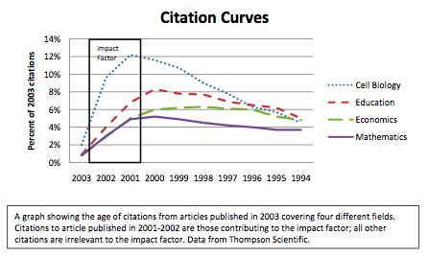
Criticism of Impact Factor 2 Two year period not appropriate

Slide 18
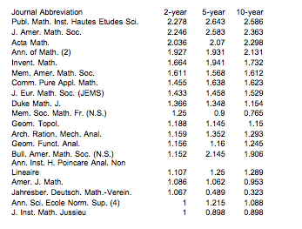
Criticism of Impact Factor 2 Two year period not appropriate
Comparison with 5 and 10 year periods:
Top 20 Journals

Slide 19
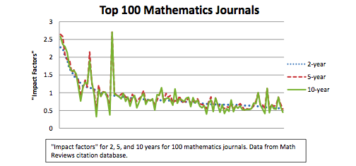
Criticism of Impact Factor 2 Two year period not appropriate
Comparison with 5 and 10 year periods:
Top 100 Journals

Slide 20
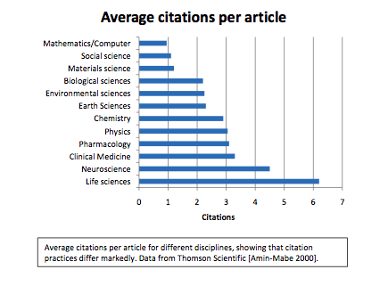
Criticism of Impact Factor 3 Impact Factor varies considerably between disciplines

Slide 21
Criticism of Impact Factor 3 Impact factor varies considerably between disciplines
If citations occur outside 2 year period
===> impact factor is lower
Impact factor measures citation cultures/behaviour,
size of disciplines/communities
===> One can not compare two journals from different disciplines using impact factors

Slide 22
Criticism of Impact Factor 4 Impact factor varies considerably from year to year
Variation tends to be larger for smaller journals
Journals with # of articles < 50: average change from 2002 to 2003 is nearly 50%
One often compares journals for a fixed year without taking into account the higher variation for small journals

Slide 23
Criticism of Impact Factor 5 Language of publication influences impact factor
Articles not written in English are likely to receive fewer citations
e.g. - Question in problem section of SIAM Review in 1970’s
Answer was given by H.-O. Kreiss in the 60’s in an
article written in German
- Fraction free Routh Algorithm. Fichera: Bullet. Della UMI
1947 in Italian: Nobody knew the result.
1979 same result in Int. Journal of Control in English

Slide 24
Criticism of Impact Factor 5 Language of publication influences impact factor
Type rather than quality of Journal will influence the impact
factor
e.g. - Review Journals may have higher, sometimes much
higher citations

Slide 25
Criticism of Impact Factor 6 Ignores sound statistical practice
When comparing two journals: there is no a priori model which defines “better”.
In statistics
- one defines a model,
- formulates a hypothesis (of no difference),
- finds a statistics on which values one accepts or
rejects the hypothesis
How does the impact factor measure quality?

Slide 26
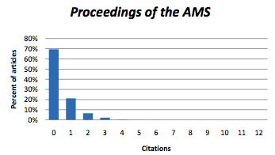
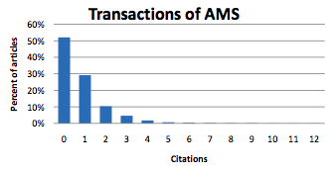
Comparison: an example
Proceedings of the AMS Transaction of the AMS
IF 0.434 0.846
Length of short more substantial
Paper < 10 pp ~ 20 pp
Are papers in the Transaction twice as good as the one in the Proceedings?
Notes:
People: Not a new effect:. Statementsi n expert letters: ‘She publishes in good journals, ‘ ‘ most of his articles are in low level journals
Chemistry: members of the search committee present wheight articles by impact factors

Slide 27
Comparison: an example
Are papers in the Transaction twice as good as the one in the
Proceedings?
Do not use averages, use probabilities.
What is the probability that a randomly selected Proceedings
paper has at least as many citations as a randomly selected
Transaction paper?
Answer
Notes:
People: Not a new effect:. Statementsi n expert letters: ‘She publishes in good journals, ‘ ‘ most of his articles are in low level journals
Chemistry: members of the search committee present wheight articles by impact factors

Slide 28
Comparison: an example
Are papers in the Transaction twice as good as the one in the
Proceedings?
Do not use averages, use probabilities.
What is the probability that a randomly selected Proceedings
paper has at least as many citations as a randomly selected
Transaction paper?
Answer 62%
Notes:
People: Not a new effect:. Statementsi n expert letters: ‘She publishes in good journals, ‘ ‘ most of his articles are in low level journals
Chemistry: members of the search committee present wheight articles by impact factors

Slide 29
Comparison: an example
Are papers in the Transaction twice as good as the one in the
Proceedings?
Do not use averages, use probabilities.
What is the probability that a randomly selected Proceedings
paper has at least as many citations as a randomly selected
Transaction paper?
Answer 62%
This means we are 62% of the time wrong!!!
Notes:
People: Not a new effect:. Statementsi n expert letters: ‘She publishes in good journals, ‘ ‘ most of his articles are in low level journals
Chemistry: members of the search committee present wheight articles by impact factors

Slide 30
Comparison: an example
Answer 62%
This means we are 62% of the time wrong!!!
a randomly selected Proceedings paper will be just as
good as (or better than) a randomly selected Transactions
paper— in spite of the fact that the Proceedings impact
factor is only half that of the Transactions!
While it is incorrect to say that the impact factor gives no
information about individual papers in a journal, the
information is surprisingly vague and can be dramatically misleading
Notes:
People: Not a new effect:. Statementsi n expert letters: ‘She publishes in good journals, ‘ ‘ most of his articles are in low level journals
Chemistry: members of the search committee present wheight articles by impact factors

Slide 31
Criticism of Impact Factor
1 ‘average’ citations: not quite correct
Two year period not appropriate
Impact factor varies considerably between disciplines
Impact factor varies considerably from year to year
Language of publication influences impact factor
Ignores sound statistical practice
===> impact factor is crude, not useless
Impact factor can not be used to compare journals across disciplines

Slide 32
Criticism of Impact Factor What is real impact?
Impact factor measures
”short time impact” in
mathematics only
not “overall impact”
Example
Radon transform 1917
’

Slide 33
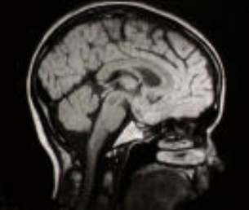
Criticism of Impact Factor What is real impact?
Impact factor measures
”short time impact” in
mathematics only
not “overall impact”
Example
Radon transform 1917
tomography, mri, pet, 60’s

Slide 34
Criticism of Impact Factor What is real impact?
Impact factor measures
”short time impact” in
mathematics only if published in ISI
not “overall impact”
Example: Perelman Result published in
arXiv (open access)

Slide 35
Criticism of Impact Factor comparison of journals of the same type
1999 2006
SIAM J Num Anal 1.119 1.335
Math Comp 0.981 1.155
Numerische Mathematik 0.968 1.116
SIAM J Math Anal 0.920 1.134
Notes:
I personally have a different ranking. SINUM has more shallow papers than Numerische Mathemaitk .SINUM
Has a restriction on the length of the articles.
Math Comp is better than the other three on FEM.If you look for articles in numerics of ode’s it is BIT one has to look at,…

Slide 36
Criticism of Impact Factor comparison with other criteria
John Ewing
IF Citation/K-pages
SIAM J Num Anal 1.119 54
Math Comp 0.981 57
Numerische Mathematik 0.968 39
SIAM J Math Anal 0.920 49

Slide 37
Criticism of Impact Factor comparison with other criteria
Other criteria:
How about
- Citations / K-pages
- Citations / K-$
- # of stolen issues in the library
- wear of journal (darkening from usage)
- # of downloads
- # of times an article is actually read
- # of times an article is actually understood

Slide 38
Misusage of Impact Factor
The Impact factor is misused to compare
individual papers
people
programs
disciplines
universities
This is a growing problem across many nations, disciplines and was made worse by recent national research assessments.
Notes:
People: Not a new effect:. Statementsi n expert letters: ‘She publishes in good journals, ‘ ‘ most of his articles are in low level journals
Chemistry: members of the search committee present wheight articles by impact factors

Slide 39
Misusage of Impact Factor
Example 1
My university has recently introduced a new classification of journals using the Science Citation Index Core journals. …. three groups based only on the impact factor.
1st: 30 journals, containing no mathematics journal.
2nd: 667 journals, which includes 21 mathematics journals. Publication in the 1st list causes university support of research to triple; in the 2nd list, to double. Publication in the core list awards 15 points; publication in any
Thompson Scientific covered journal awards 10.
Promotion requires a fixed minimum number of points.
Notes:
People: Not a new effect:. Statementsi n expert letters: ‘She publishes in good journals, ‘ ‘ most of his articles are in low level journals
Chemistry: members of the search committee present wheight articles by impact factors

Slide 40
Misusage of Impact Factor
Example 2
In our department, each faculty member is evaluated by a formula involving the number of single‐author‐equivalent papers, multiplied by the impact factor of the journals in which they appear. Promotions and hiring are based partly on this formula.
Question?
Why not multiply the impact factor by the number of pages and then divide by the number of authors?
Why not read the article?
Notes:
People: Not a new effect:. Statementsi n expert letters: ‘She publishes in good journals, ‘ ‘ most of his articles are in low level journals
Chemistry: members of the search committee present wheight articles by impact factors

Slide 41
Ranking Scientists
Wish to measure scientific output of a researcher
by a simple number
not just counting publications
not just citations
but a single number combining both
Answer
h-index, m-index, g-index, …
Notes:
People: Not a new effect:. Statementsi n expert letters: ‘She publishes in good journals, ‘ ‘ most of his articles are in low level journals
Chemistry: members of the search committee present wheight articles by impact factors

Slide 42
Ranking Scientists
h-index A scientist's h‐index is the largest n for which he/she has published n articles, each with at least n citations
most popular, focuses of high-end ‘tail’ of a persons
citation distribution, created by Hirsch.
Notes:
People: Not a new effect:. Statementsi n expert letters: ‘She publishes in good journals, ‘ ‘ most of his articles are in low level journals
Chemistry: members of the search committee present wheight articles by impact factors

Slide 43
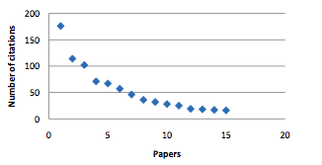
Ranking Scientists
h-index A scientist's h‐index is the largest n for which he/she has published n articles, each with at least n citations
Hirsch claims:
- can be used to compare scientists
- tested it on Nobel Prize winners, members of the
National Academy: these have generally very high
very high?
Notes:
People: Not a new effect:. Statementsi n expert letters: ‘She publishes in good journals, ‘ ‘ most of his articles are in low level journals
Chemistry: members of the search committee present wheight articles by impact factors

Slide 44
Ranking Scientists
h-index A scientist's h‐index is the largest n for which he/she has published n articles, each with at least n citations
Hirsch claims:
- can be used to compare scientists
- tested it on Nobel Prize winners, members of the
National Academy: these have generally very high
very high?
Notes:
People: Not a new effect:. Statementsi n expert letters: ‘She publishes in good journals, ‘ ‘ most of his articles are in low level journals
Chemistry: members of the search committee present wheight articles by impact factors

Slide 45
Ranking Scientists
h-index A scientist's h‐index is the largest n for which he/she has published n articles, each with at least n citations
Hirsch claims:
- can be used to compare scientists
- tested it on Nobel Prize winners, members of the
National Academy: these have generally very high
h-index.
Is the likelyhood of a scientist with a very high h-index
to become Nobel Laureat very high?
Notes:
People: Not a new effect:. Statementsi n expert letters: ‘She publishes in good journals, ‘ ‘ most of his articles are in low level journals
Chemistry: members of the search committee present wheight articles by impact factors

Slide 46
Ranking Scientists
Is the likelyhood of a scientist with a very high h-index
to become Nobel Laureat very high?
Examples:
Business: CEO’s are generally men and taller than 1.80 m
Is the likelyhood of man, taller than 1.80 m, to become
a CEO very high?
Medicine: Persons which became old had a bodymass index in range of the low 20’s.
Is a young person healthy, just because his/her bodymass index is 23, say?
Notes:
People: Not a new effect:. Statementsi n expert letters: ‘She publishes in good journals, ‘ ‘ most of his articles are in low level journals
Chemistry: members of the search committee present wheight articles by impact factors

Slide 47
Ranking Scientists
m-index A scientist's m‐index is the h‐index divided by the number of years since his/her first paper
compensation for junior scientists
g-index A scientist's g‐index is the n for which the most cited papers have a total of at least n² citations
compensate for extraordinarily high citation counts
Many more similar indices
Notes:
People: Not a new effect:. Statementsi n expert letters: ‘She publishes in good journals, ‘ ‘ most of his articles are in low level journals
Chemistry: members of the search committee present wheight articles by impact factors

Slide 48
Meaning of Citations
Why do we cite?
What do we cite?
- opening a new field with ideas (A-Stability)
- original article, result important
- article/book is well written
- result not very good, want to show that present
is better
- article has error, makes wrong statements
- want to show that present authors has looked at
all previous articles
…..
Notes:
- Aim: Ranking thinngs: We do it al the time
- Needed (we do it all the time! When buying things, bananas, …, sports (olympics, Tennis)
investment in AAA, AAA-,…
only in paradis Eva had no choice of men!
What ? In academics: a student shops for the best education
a department wants to hire the best people, wants to give salary according to ‘quality’
a political body wants to support institutions according to their ranking
Ranking across fields (compare mathematics with sociology) [Compare 100 meters running
with latin dancing]
How? Simple, quick, objective, unerring, with numbers, gut feeling,

Slide 49
Meaning Citations
When is an article not cited?
- article closes a field by giving a definite answer
- article is followed by a well written book which
is readily available
===> Meaning of citation is
- not always clear!!!
Notes:
- Aim: Ranking thinngs: We do it al the time
- Needed (we do it all the time! When buying things, bananas, …, sports (olympics, Tennis)
investment in AAA, AAA-,…
only in paradis Eva had no choice of men!
What ? In academics: a student shops for the best education
a department wants to hire the best people, wants to give salary according to ‘quality’
a political body wants to support institutions according to their ranking
Ranking across fields (compare mathematics with sociology) [Compare 100 meters running
with latin dancing]
How? Simple, quick, objective, unerring, with numbers, gut feeling,

Slide 50
Meaning Citations
When is an article not cited?
- article closes a field by giving a definite answer
- article is followed by a well written book which
is readily available
===> Meaning of citation is
- not always clear!!!
- not always positive!!!
Notes:
- Aim: Ranking thinngs: We do it al the time
- Needed (we do it all the time! When buying things, bananas, …, sports (olympics, Tennis)
investment in AAA, AAA-,…
only in paradis Eva had no choice of men!
What ? In academics: a student shops for the best education
a department wants to hire the best people, wants to give salary according to ‘quality’
a political body wants to support institutions according to their ranking
Ranking across fields (compare mathematics with sociology) [Compare 100 meters running
with latin dancing]
How? Simple, quick, objective, unerring, with numbers, gut feeling,

Slide 51
Societies should react: How?
IMU, ICIAM: New working group on
Journal Ranking and Pricing 19. 10. 2010
N.Joshi, Sydney (Chair)
D. N. Arnold, Minneapolis (Initiator abuse of impact factor)
C. Hutchinson, New York (Librarian)
M.A.H. Mccallum, Bristol
P. Michor, Vienna
S. Müller (Initiator journal pricing)Bonn
T. Tang, Hong Kong
Notes:
- Aim: Ranking thinngs: We do it al the time
- Needed (we do it all the time! When buying things, bananas, …, sports (olympics, Tennis)
investment in AAA, AAA-,…
only in paradis Eva had no choice of men!
What ? In academics: a student shops for the best education
a department wants to hire the best people, wants to give salary according to ‘quality’
a political body wants to support institutions according to their ranking
Ranking across fields (compare mathematics with sociology) [Compare 100 meters running
with latin dancing]
How? Simple, quick, objective, unerring, with numbers, gut feeling,

Slide 52
Societies should react: How?
Working group on Journal Ranking and Pricing
Charge:
1. How should ICIAM and IMU actively react
to the mentioned problems?
Propose ideas?
Notes:
- Aim: Ranking thinngs: We do it al the time
- Needed (we do it all the time! When buying things, bananas, …, sports (olympics, Tennis)
investment in AAA, AAA-,…
only in paradis Eva had no choice of men!
What ? In academics: a student shops for the best education
a department wants to hire the best people, wants to give salary according to ‘quality’
a political body wants to support institutions according to their ranking
Ranking across fields (compare mathematics with sociology) [Compare 100 meters running
with latin dancing]
How? Simple, quick, objective, unerring, with numbers, gut feeling,

Slide 53
Societies should react: How?
Working group on Journal Ranking and Pricing
Charge:
2. Each proposed idea should be
accompanied by an estimate of the efforts
involved in establishing and maintaining an
implementation of the idea in the long run.
Notes:
- Aim: Ranking thinngs: We do it al the time
- Needed (we do it all the time! When buying things, bananas, …, sports (olympics, Tennis)
investment in AAA, AAA-,…
only in paradis Eva had no choice of men!
What ? In academics: a student shops for the best education
a department wants to hire the best people, wants to give salary according to ‘quality’
a political body wants to support institutions according to their ranking
Ranking across fields (compare mathematics with sociology) [Compare 100 meters running
with latin dancing]
How? Simple, quick, objective, unerring, with numbers, gut feeling,

Slide 54
Societies should react: How?
Working group on Journal Ranking and Pricing
Charge:
3. Comment on the possible effects of each
proposal, e.g., on changes in the
behavior of researchers, universities,
funding agencies, publishers etc.
Legal implications?
Notes:
- Aim: Ranking thinngs: We do it al the time
- Needed (we do it all the time! When buying things, bananas, …, sports (olympics, Tennis)
investment in AAA, AAA-,…
only in paradis Eva had no choice of men!
What ? In academics: a student shops for the best education
a department wants to hire the best people, wants to give salary according to ‘quality’
a political body wants to support institutions according to their ranking
Ranking across fields (compare mathematics with sociology) [Compare 100 meters running
with latin dancing]
How? Simple, quick, objective, unerring, with numbers, gut feeling,

Slide 55
Societies should react: How?
Working group on Journal Ranking and Pricing
Charge:
4. Should the mathematical community create
their own journal ranking? Include preprint
servers? Workload? Practicality? How has
this process to be organized?
Notes:
- Aim: Ranking thinngs: We do it al the time
- Needed (we do it all the time! When buying things, bananas, …, sports (olympics, Tennis)
investment in AAA, AAA-,…
only in paradis Eva had no choice of men!
What ? In academics: a student shops for the best education
a department wants to hire the best people, wants to give salary according to ‘quality’
a political body wants to support institutions according to their ranking
Ranking across fields (compare mathematics with sociology) [Compare 100 meters running
with latin dancing]
How? Simple, quick, objective, unerring, with numbers, gut feeling,

Slide 56
Societies should react: How?
Working group on Journal Ranking and Pricing
Charge:
5. How to protect against the inappropriate
use of impact factors and similar
manipulable indices for evaluating
research.
Notes:
- Aim: Ranking thinngs: We do it al the time
- Needed (we do it all the time! When buying things, bananas, …, sports (olympics, Tennis)
investment in AAA, AAA-,…
only in paradis Eva had no choice of men!
What ? In academics: a student shops for the best education
a department wants to hire the best people, wants to give salary according to ‘quality’
a political body wants to support institutions according to their ranking
Ranking across fields (compare mathematics with sociology) [Compare 100 meters running
with latin dancing]
How? Simple, quick, objective, unerring, with numbers, gut feeling,

Slide 57
IF versus peer reviewed rating
D.N. Arnold, K.K. Fowler, Nefarious Numbers
http://arxiv.org/abs/1010.0278
ERA Rating: Australian Research Council requested that 20000
journals be rated by learned academies and disciplinary
bodies (e.g. Australian Math. Soc.)
http://www.arc.gov.au/era/journal_list_dev.htm
4 Categories: A* one of the best in its field or subfield
A very high quality
B solid, though not outstanding
C does not meet the criteria of higher tiers
Notes:
- Aim: Ranking thinngs: We do it al the time
- Needed (we do it all the time! When buying things, bananas, …, sports (olympics, Tennis)
investment in AAA, AAA-,…
only in paradis Eva had no choice of men!
What ? In academics: a student shops for the best education
a department wants to hire the best people, wants to give salary according to ‘quality’
a political body wants to support institutions according to their ranking
Ranking across fields (compare mathematics with sociology) [Compare 100 meters running
with latin dancing]
How? Simple, quick, objective, unerring, with numbers, gut feeling,

Slide 58
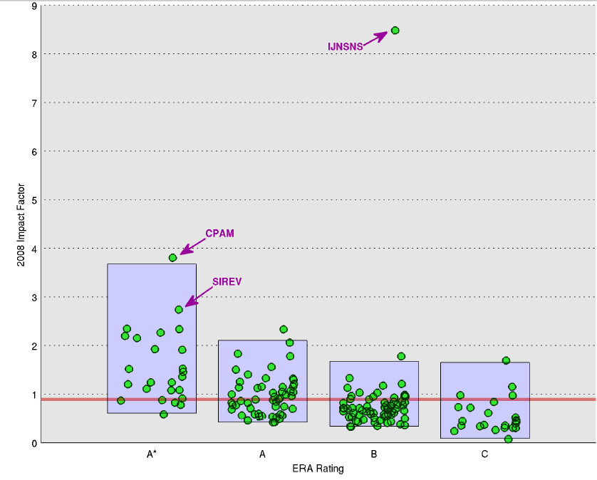
IF versus peer reviewed rating
N. Arnold, K.K. Fowler, Nefarious Numbers
Notes:
- Aim: Ranking thinngs: We do it al the time
- Needed (we do it all the time! When buying things, bananas, …, sports (olympics, Tennis)
investment in AAA, AAA-,…
only in paradis Eva had no choice of men!
What ? In academics: a student shops for the best education
a department wants to hire the best people, wants to give salary according to ‘quality’
a political body wants to support institutions according to their ranking
Ranking across fields (compare mathematics with sociology) [Compare 100 meters running
with latin dancing]
How? Simple, quick, objective, unerring, with numbers, gut feeling,

Slide 59
Societies should react: How?
Working group on Journal Ranking and Pricing
Charge:
Preliminary report to be delivered:
18 February 2011
Notes:
- Aim: Ranking thinngs: We do it al the time
- Needed (we do it all the time! When buying things, bananas, …, sports (olympics, Tennis)
investment in AAA, AAA-,…
only in paradis Eva had no choice of men!
What ? In academics: a student shops for the best education
a department wants to hire the best people, wants to give salary according to ‘quality’
a political body wants to support institutions according to their ranking
Ranking across fields (compare mathematics with sociology) [Compare 100 meters running
with latin dancing]
How? Simple, quick, objective, unerring, with numbers, gut feeling,

Slide 60
THANK YOU !

